Slide 1
Digital Portfolio
STUDENT NAME: Velmurugan M
REGISTER NO AND NMID: 2422j0160 And asbruaz2422j0160 DEPARTMENT: BCA
COLLEGE: KPR College Of Arts Science And Research Bharathiyar University

Slide 2
PROJECT TITLE
W e b D e ve lo p m e n t P o rtfolio u sin g H T M L, C S S , a n d
Ja va S crip t

Slide 3


AGEND
A
P ro blem S ta te m e nt
Pro ject O v erv iew
E n d U sers
4 .T o ols an d T ech n olo gie s
Po rtfo lio d esig n an d La yo ut
F e atu res an d F u nction ality
.R esu lts a n d S cre en sho ts
.C o nclu sio n
9 . G ith ub Link
3/21/2024 Annual Review

Slide 4

PROBLEM STATEMENT
M a n y stu de n ts a nd d ev elop e rs la ck a structu re d w ay to sh o w ca se th eir skills
a nd p ro je cts. T ra ditio na l re su m e s fail to h ig hlig h t in te ractive a n d v isu a l a sp e cts o f o ne ’ s w o rk. H en ce , th e re is a n e e d for a d ig ita l p ortfo lio th a t ca n pre se nt
skills, p ro je cts, a nd a ch iev em en ts in a n e ng a gin g w a y.

Slide 5

PROJECT OVERVIEW
T h e p ro je ct is a p e rso n a l
p o rtfolio w e b site d e ve lo p e d u sin g H T M L, C S S , a nd
Ja va S crip t. It sh o w ca se s
p e rso n al d e tails, sk ills , p ro je cts, a n d co nta ct in fo rm a tio n in a
re sp o n sive a n d u se r- frie n d ly layo u t. It is de sig ne d to se rve a s a n o n lin e resu m e a nd
5

Slide 6

WHOARE THE END USERS?
S tu de nts an d gra du ate s se eking in te rnsh ips o r jo bs
R ecruite rs a n d h irin g m a na ge rs
F re elan ce rs sh ow casin g th eir se rvice s C lien ts loo k in g fo r w e b de ve lo pe rs

Slide 7


TOOLS AND TECHNIQUES
H T M L 5 → S tru ctu re of the w e bsite.
C S S 3 → S tyling , an im a tio ns, resp onsive de sign.
Ja va S cript → Intera ctivity ( form su bm issio n alert).
V S C od e → C o de e ditor.
G itH ub P a ges → F re e h osting fo r m ak ing portfolio live .

Slide 8

POTFOLIO DESIGN AND LAYOUT
S im ple , colo rfu l, a nd use r- frien dly la yout.
A nim ated gradie n t ba ckgrou nd fo r m ode rn look.
N a vig ation bar for sm o oth m o ve m e nt be tw ee n section s.
R ou nde d profile p hoto, skill ba dge s, an d proje ct cards w ith ho ve r effects.

Slide 9

FEATURES AND FUNCTIONALITY
▶A bou t M e se ction to introdu ce m yse lf.
▶S k ills se ction to sh ow case progra m m ing kn ow ledge .
▶P roje cts se ction w ith sam ple w orks.
▶C on tact F orm for e asy com m u nica tion

Slide 10
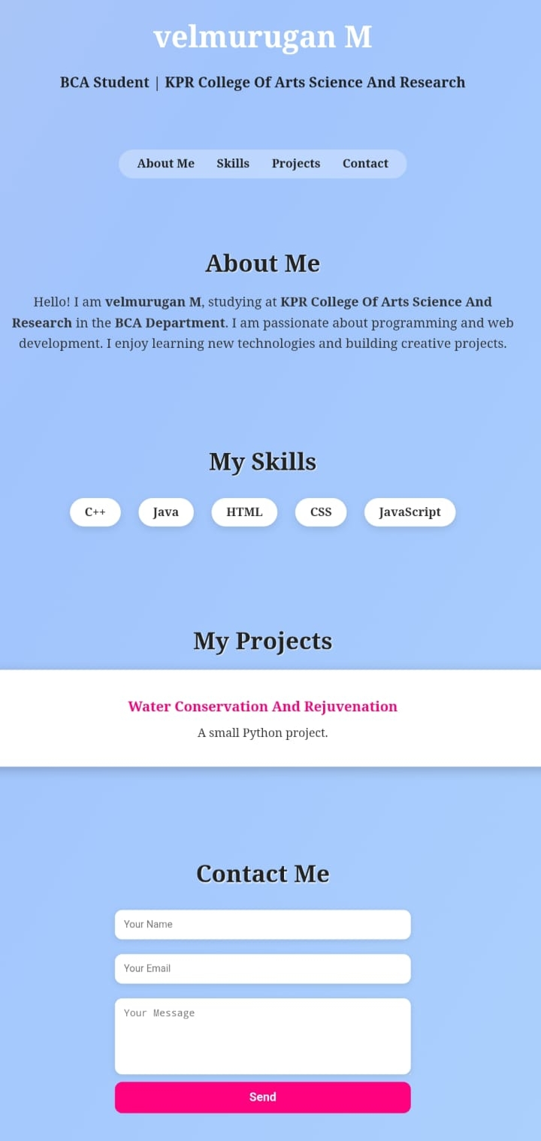

RESULTS AND SCREENSHOTS
3/21/2024 Annual Review

Slide 11
GITHUB LINK
https://github.com/vm441963-jpg/Velmurugan-digital-portfolio-.git

Slide 12

CONCLUSION
This p erson al portfo lio w e bsite h igh ligh ts m y skills,
proje cts, a nd a cad em ic back groun d in a profe ssion al an d colorful w ay. It acts as m y d igita l id en tity , m a king it e a sy for othe rs to kno w ab out m e an d con ta ct m e

